Slide 1
Expense Tracker
An expense tracking application built to manage day-to-day expenses
Presented by: Harshit(12306540)
Course Code: CSM-216
Lovely Professional University

Slide 2
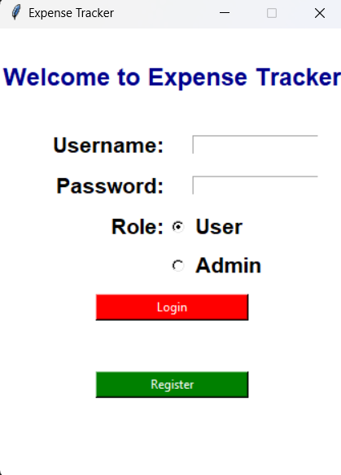
Introduction
Managing money shouldn’t be a mystery, yet so often, it feels like our hard-earned cash vanishes without a trace. Expense Tracker changes that. Built with Python, Tkinter, and SQLite, this app is your personal finance assistant, letting you track spending, check balances, transfer funds, and view transaction history—all in one secure and user-friendly platform. Whether for personal use or managing shared expenses in places like hostels, its admin feature ensures smooth oversight.

Slide 3
Objective
Key functionalities:
Add Expenses
Delete Expenses
Update Expenses
Filter Expenses
View History
View Expenses
Set Limit
Admin Functionalties
Scope
1.User Role: Manage accounts, transfer funds, and track transactions.
Admin Role: Create accounts and monitor activities.
Architecture: Built with Python, Tkinter, and MySQL.
Security: Emphasizes data validation and robust error handling.

Slide 4
Project Design
The Expense Tracker application is built with a simple and functional design to effectively manage user and admin tasks.
User Interface:
Developed using Tkinter, the interface includes basic buttons and input fields for ease of use.
Features are straightforward, focusing on functionality over advanced aesthetics.
Backend Architecture:
MySQL is used for data storage, ensuring a structured and reliable database for user and transaction records.
Core modules are designed for user management, transaction handling, and admin oversight.
Data Flow:
The application processes user inputs through Python scripts, connecting seamlessly to the database for data retrieval and updates.
Transaction histories and account details are displayed in real-time for user convenience.
Security:
Basic data validation ensures that inputs are accurate and consistent.
Error handling is implemented to prevent disruptions during operation.

Slide 5
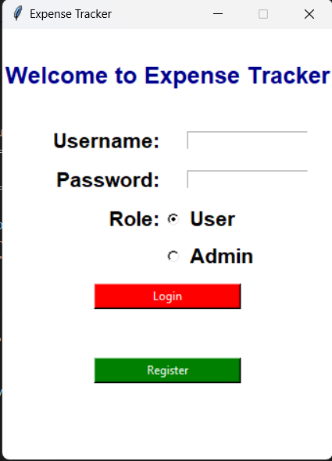
Login Page
The Login Page is the secure gateway to the Expense Tracker application, offering an intuitive and seamless experience for both users and admins. Upon visiting the page, users can easily select whether they want to login or sign up as a regular user or an admin. This ensures proper access control while maintaining a simple and efficient design. With robust password validation and clear error messages, the login process is secure and user-friendly. The page's responsive layout ensures a smooth experience across various screen sizes, making it accessible and secure on all devices.

Slide 6
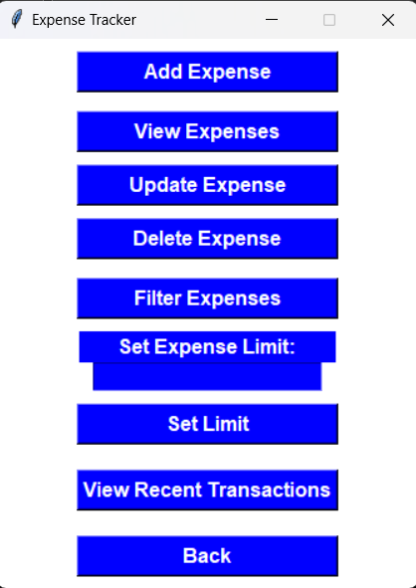
Dashboard
The User Dashboard is the central hub for regular users to track and manage their expenses efficiently. Upon logging in, users are greeted with a clean, organized interface showcasing an overview of their recent expenses, categorized for easy reference. The dashboard allows users to add new expenses, view detailed expense records, and edit or delete any entries. The layout is designed for simplicity, ensuring a smooth experience for users to monitor their financial habits and make quick updates as needed. The dashboard is responsive and provides a seamless experience on all devices, empowering users to stay on top of their finances anytime, anywhere.

Slide 7
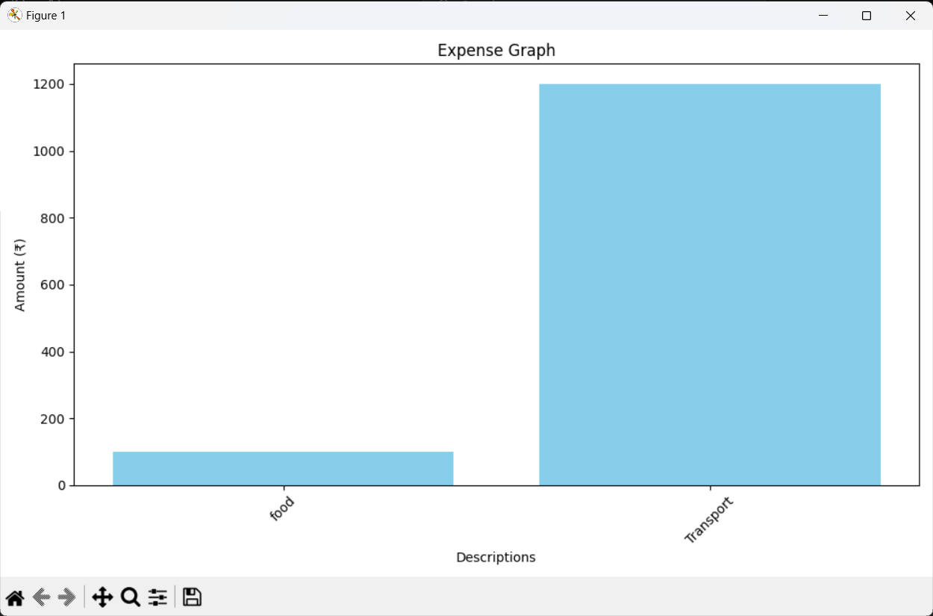
View Expenses
The View Expenses functionality allows users to simply see on what category people spent the most and least amount of money respectively and can track down their expenses easily

Slide 8
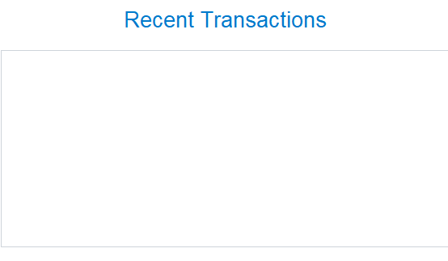
Recent Transactions
In the recent transactions column, users can simply check their most recent transactions which they did recently along with the amount and category in which they spent money which makes it easy to check last transactions which they made every time they open the application

Slide 9
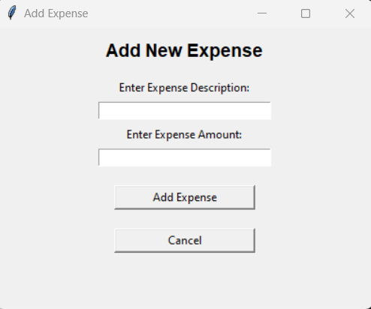
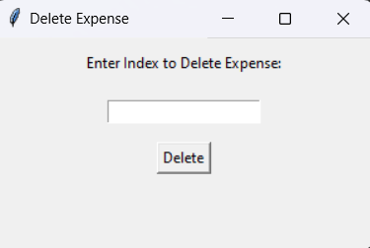
Add Expense:
The user can simply add expense after entering the category, amount , date and description so that the data remains structured and well formatted .
Delete Expense:
The user can delete an expense which he wants just by simply putting the expense is and thus the particular expense will get deleted automatically

Slide 10
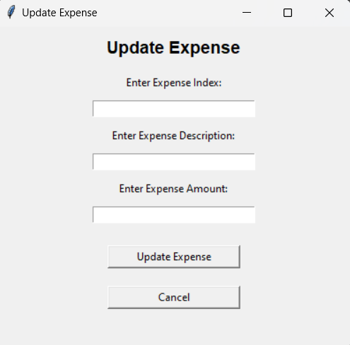
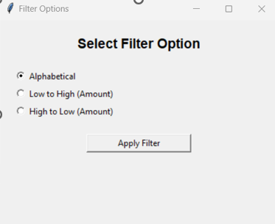
Update Expense
If a user by mistake enters wrong amount/category , he can simply update the expense by using an expense id which appears on the recent transactions section and it will auto-fetch the information(category , amount ,date , description etc.) and then the user can change whatever he wants.
Filter Expense
If a user wants to see his transactions in a particular category/timeline, the user can simply filter the other expenses instead of viewing the recent transactions using the filter expense category, which can make user’s work easy and quick.

Slide 11
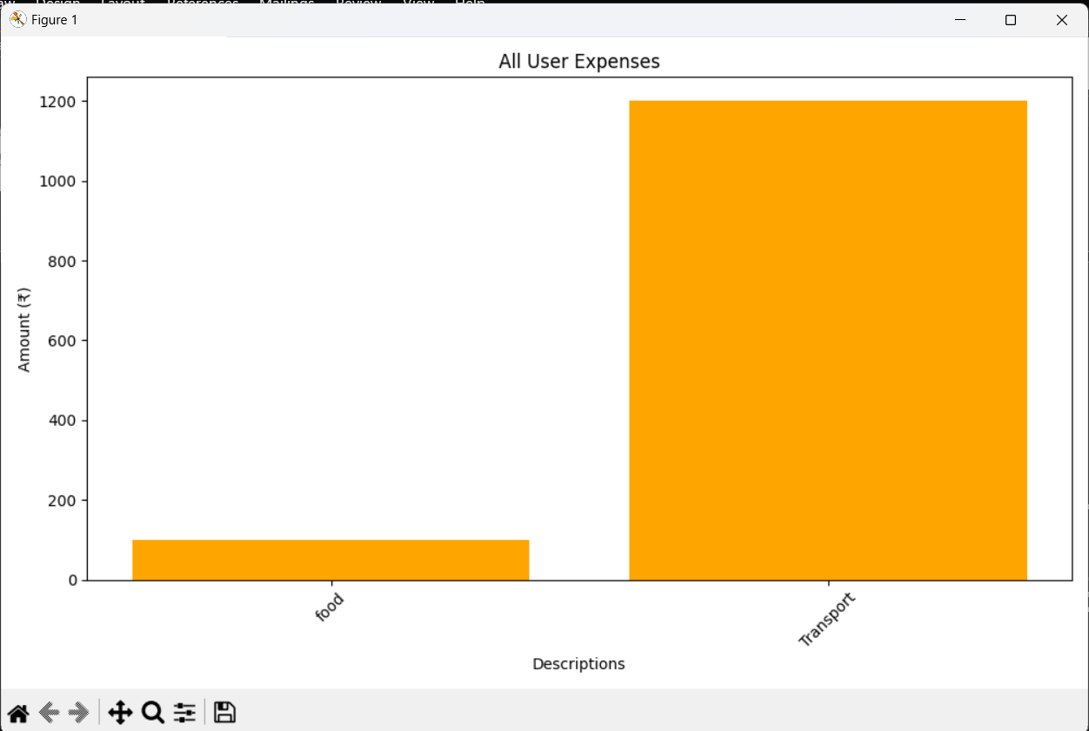
Admin View
In the scenario of a big family or a hostel premises, an admin can see the expenditures of all of the users and can track down their respective expenses using the View User Expenditure functionality in form of bar graph charts which makes it easy for the admin to see who spent how much money and can even cut down the pocket money of the user who spends too much by putting a limit to their expenditures.

Slide 12
Conclusion and Future Scope
The Expense Tracker project marks a significant achievement in applying Python, SQL, and Tkinter to develop a practical tool for managing personal expenses. The application enables users to track, categorize, and manage their daily expenditures efficiently, offering essential features like adding, editing, and viewing expenses. By integrating a user-friendly interface with a reliable backend system, this project demonstrates how technology can simplify financial management in daily life. Although the current version focuses on core functionalities, it serves as a foundation for potential future enhancements, such as advanced reporting and budgeting features. The development process emphasized the importance of clear design, efficient database management, and a responsive, intuitive user experience. As digital tools for financial management continue to grow, this expense tracker project showcases the potential to create accessible and valuable applications that help users take control of their finances. Beyond fulfilling the course requirements, this project provides practical insights into developing secure, user-centric applications that address real-world financial management needs.

Slide 13
Thank You!!!

